Slide 1
Mockup Design
Group 7

Slide 2
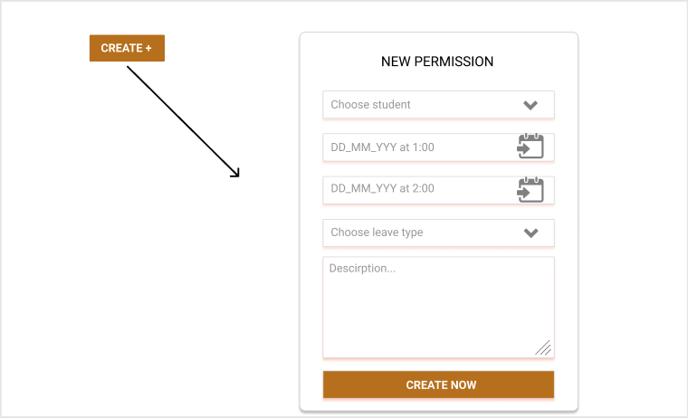

Slide 3
